Slide 1
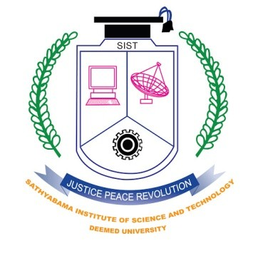
SCSA1503 -FOG AND CLOUD COMPUTING
COURSE HANDLED BY
Dr.M.R.EBENEZAR JEBARANI
Dr. MEERA GANDHI

Slide 2
UNIT 1 UNDERSTANDING CLOUD COMPUTING
Basic Concepts and Terminology
Cloud Computing Architectural Framework
Types of Clouds
pros and cons of cloud computing
Cloud Characteristics
difference between web 2.0 and cloud
key challenges in cloud computing
Major Cloud players
Virtualization in Cloud Computing
Parallelization in Cloud Computing
cloud resource management
Cloud Enabling Technology

Slide 3
UNIT 2 CLOUD SERVICE MODELS
Software as a Service (SaaS)
Infrastructure as a Service (IaaS)
Platform as a Service (PaaS)
Web services
Service Oriented Architecture (SoA)
Elastic Computing
On Demand Computing
Service Management in Cloud Computing
Multi-tenancy computing , architecture

Slide 4
UNIT 3 CLOUD DEPLOYMENT MODELS
AND VIRTUALIZATION
Deployment models:
Public cloud
Private Cloud
Hybrid cloud
Community cloud
Need for virtualization
Types of Virtualization
Virtualization OS
VMware, KVM
System VM
Process VM
Virtual Machine Monitor
Properties - Xen, Hyper V, Virtual Box, Eucalyptus

Slide 5
UNIT 4 MANAGEMENT IN CLOUD COMPUTING AND SECURITY
Cloud data centres
Energy efficiency in data centre
Data Management in Cloud Computing
Mobile cloud computing
service models
Open Source and Commercial Clouds
Cloud Simulator - sensor cloud
Fundamental Cloud security
Cloud security Threads
Additional considerations
Security solutions a case study

Slide 6
UNIT 5 FOG COMPUTING
From Cloud to Fog
Fog Computing architecture
fog networks
Principles of Edge/P2P networking
Security and privacy in Fog

Slide 7
Advantages of Cloud Computing
Lower computer costs:
No need of a high-powered and high-priced computer to run cloud computing's web-based applications.
Since applications run in the cloud, not on the desktop PC, your desktop PC does not need the processing power or hard disk space demanded by traditional desktop software.
When you are using web-based applications, your PC can be less expensive, with a smaller hard disk, less memory, more efficient processor...
In fact, your PC in this scenario does not even need a CD or DVD drive, as no software programs have to be loaded and no document files need to be saved.

Slide 8
Advantages of Cloud Computing
Improved performance:
With few large programs hogging your computer's memory, you will see better performance from your PC.
Computers in a cloud computing system boot and run faster because they have fewer programs and processes loaded into memory.
Reduced software costs:
Instead of purchasing expensive software applications, you can get most of what you need for free.
most cloud computing applications today, such as the Google Docs suite.
better than paying for similar commercial software
which alone may be justification for switching to cloud applications.

Slide 9
Advantages of Cloud Computing
Instant software updates
Another advantage to cloud computing is that you are no longer faced with choosing between obsolete software and high upgrade costs.
When the application is web-based, updates happen automatically available the next time you log into the cloud.
When you access a web-based application, you get the latest version without needing to pay for or download an upgrade.
Improved document format compatibility.
You do not have to worry about the documents you create on your machine being compatible with other users' applications or OS.
There are less format incompatibilities when everyone is sharing documents and applications in the cloud.

Slide 10
Advantages of Cloud Computing
Unlimited storage capacity
Cloud computing offers virtually limitless storage.
Your computer's current 1 Tera Bytes(1000GB) hard drive is small compared to the hundreds of Peta Bytes(1Peta=1000000GB) available in the cloud.
Increased data reliability
Unlike desktop computing, in which if a hard disk crashes and destroy all your valuable data, a computer crashing in the cloud should not affect the storage of your data.
if your personal computer crashes, all your data is still out there in the cloud, still accessible
In a world where few individual desktop PC users back up their data on a regular basis, cloud computing is a data-safe computing platform. For e.g. Dropbox, Skydrive

Slide 11
Advantages of Cloud Computing
Universal information access
That is not a problem with cloud computing, because you do not take your
documents with you.
Instead, they stay in the cloud, and you can access them whenever you have a computer and an Internet connection
Documents are instantly available from wherever you are.
Latest version availability
When you edit a document at home, that edited version is what you see when
you access the document at work.
The cloud always hosts the latest version of your documents as long as you are connected, you are not in danger of having an outdated version.

Slide 12
Advantages of Cloud Computing
Easier group collaboration
Sharing documents leads directly to better collaboration.
Many users do this as it is an important advantages of cloud computing multiple users can collaborate easily on documents and projects
Device independence
You are no longer tethered to a single computer or network.
Changes to computers, applications and documents follow you through the cloud.
Move to a portable device, and your applications and documents are still available.

Slide 13
Disadvantages of Cloud Computing
Requires a constant internet connection
Cloud computing is impossible if you cannot connect to the Internet.
Since you use the Internet to connect to both your applications and documents, if you do not have an Internet connection you cannot access anything, even your own documents.
A dead Internet connection means no work and in areas where Internet connections are few or inherently unreliable, this could be a deal-breaker.
Does not work well with low-speed connections
Similarly, a low-speed Internet connection, such as that found with dial-up services, makes cloud computing painful at best and often impossible.
Web-based applications require a lot of bandwidth to download, as do large documents.

Slide 14
Disadvantages of Cloud Computing
Features might be limited
This situation is bound to change, but today many web-based applications simply are not as full-featured as their desktop-based applications.
For example, you can do a lot more with Microsoft PowerPoint than with Google Presentation's web-based offering
Can be slow
Even with a fast connection, web-based applications can sometimes be slower than accessing a similar software program on your desktop PC.
Everything about the program, from the interface to the current document, has to be sent back and forth from your computer to the computers in the cloud.
If the cloud servers happen to be backed up at that moment, or if the Internet is having a slow day, you would not get the instantaneous access you might expect from desktop applications.

Slide 15
Disadvantages of Cloud Computing
Stored data might not be secured
With cloud computing, all your data is stored on the cloud.
The questions is How secure is the cloud?
Can unauthorized users gain access to your confidential data ?
Stored data can be lost!
Theoretically, data stored in the cloud is safe, replicated across multiple machines.
But on the off chance that your data goes missing, you have no physical or local backup.
Put simply, relying on the cloud puts you at risk if the cloud lets you down.

Slide 16
Disadvantages of Cloud Computing
HPC (High Performance computing Systems)
Not clear that you can run compute-intensive HPC applications that use MPI(MPI uses a message passing mechanism to divide a big problem into smaller problems. Each small problem runs on a separate machine, in parallel with the other./OpenMP(OpenMP is used to optimize performance of a program running on a single machine with multiple CPUs, i.e an SMP-Symmetric Multiprocessing)
Scheduling is important with this type of application
as you want all the VM to be co-located to minimize communication latency
General Concerns
Each cloud systems uses different protocols and different APIs
may not be possible to run applications between cloud based systems
Amazon has created its own DB system (not SQL 92-was the third revision of the SQL database query language), and workflow system (many popular workflow systems out there)
so your normal applications will have to be adapted to execute on these platforms.

Slide 17
Cloud Services Network
Cloud services can be delivered publicly or privately using the internet and can also remain within a company’s network when delivered over an intranet. Sometimes, organizations make use of a combination of both.
No matter where the actual “cloud” is—a company’s own data center or a service provider’s data center, cloud computing uses networking to enable convenient, on-demand access to a shared pool of computing resources like networks, storage, servers, services, and applications.
By using virtualization, these assets can be provisioned and released quickly and easily as necessary.

Slide 18
Virtually Served
Most of the time, servers don't run at full capacity.
That means there's unused processing power going to waste.
It's possible to fool a physical server into thinking it's actually multiple servers, each running with its own independent operating system.
The technique is called server virtualization.
By maximizing the output of individual servers, server virtualization reduces the need for more physical machines.

Slide 19
Cloud Computing Applications
Clients would be able to access their applications and data from anywhere at any time.
It could bring hardware costs down.
Corporations that rely on computers have to make sure they have the right software in place to achieve goals.
Servers and digital storage devices take up space.
Corporations might save money on IT support.
If the cloud computing system's back end is a grid computing system, then the client could take advantage of the entire network's processing power.

Slide 20
Cloud Computing Concerns
Perhaps the biggest concerns about cloud computing are security and privacy, Authentication, authorization
Private Eyes Are Watching You
There are a few standard hacker tricks that could cause cloud computing companies major headaches. One of those is called key logging. A key logging program records keystrokes(Keystroke logging, often referred to as keylogging or keyboard capturing, is the action of recording the keys struck on a keyboard, typically covertly, so that a person using the keyboard is unaware that their actions are being monitored). If a hacker manages successfully to load a key logging program on a victim's computer, he or she can study the keystrokes to discover user names and passwords. Of course, if the user's computer is just a streamlined terminal, it might be impossible to install the program in the first place.
Same As It Ever Was
Cloud computing could turn home computers into simple terminal interfaces. In some ways, this is a step backward. Early computers included hardwired user terminals. Each terminal had a computer monitor and keyboard, but they only served as an interface to the main computer. There was no way to store information locally on a terminal.

Slide 21
Cloud Computing features and benefits
Highly virtualized and standardized infrastructures
Massive scalability
Fault tolerant and highly reliable
Intra & Inter cloud load balance
Instant application deployment
Simplified more efficient IT and application management
Deliver more applications to large number of users
Excellent service quality
Higher utilization at the reduced cost
Time-to-market

Slide 23
Deployment Models
Public Cloud
Private Cloud
Hybrid Cloud
Community Cloud

Slide 24
Public Cloud
Public cloud allows the accessibility of systems and services easily to general public. Eg: Amazon, IBM, Microsoft, Google, Rackspace etc
Public cloud is better suited for business purposes for managing the load. This type of cloud is economical due to the decrease in capital overheads.

Slide 25
Advantages of Public Cloud Model
Low Cost
Reliable
Flexible
Location Independent
High Scalability

Slide 26
Disadvantages of Public Cloud Model
Low security
In public cloud model, data is present off-site and resources are shared publicly. Hence it does not ensure the high level security.
Less customizable
It is less customizable than private cloud.

Slide 27
Private Cloud
Private Cloud also termed as 'Internal Cloud'; which allows the accessibility of systems and services within a specific boundary or organization.
The Private cloud allows the accessibility of systems and services within the organization. Private cloud is operated only within a particular organization. But it will be managed internally or by third party.
The cloud platform is implemented in a cloud-based secure environment that is guarded by advanced firewalls under the surveillance of the IT department that belongs to a particular organization.
Private clouds permit only authorized users, providing the organizations greater control over data and its security.
Business organizations that have dynamic, critical, secured, management demand based requirement should adopt Private Cloud.

Slide 28
The advantages of using private cloud
Highly private and secured - Private cloud resource sharing is highly secured.
Control Oriented- Private clouds provide more control over its resources than public cloud as it can be accessed within the organization's boundary.

Slide 29
Disadvantages
Poor scalability - Private type of clouds is scaled within internal limited hosted resources.
Costly - As it provides secured and more features, so it's more expensive than a public cloud.
Pricing - is inflexible; i.e., purchasing new hardware for up-gradation is more costly.
Restriction - It can be accessed locally within an organization and is difficult to expose globally.

Slide 30
Hybrid Cloud
Hybrid Cloud is another cloud computing type, which is integrated, i.e., it can be a combination of two or more cloud servers, i.e., private, public or community combined as one architecture, but remain individual entities
Non-critical tasks such as development and test workloads can be done using public cloud whereas critical tasks that are sensitive such as organization data handling are done using a private cloud.
Benefits of both deployment models, as well as community deployment model, are possible in a hybrid cloud hosting

Slide 31
Advantages of Hybrid Cloud Model
Scalable
-It provides both the features of public and private cloud scalability.
Flexible and secure
- It provides secure resources because of private cloud and scalable resources because of public cloud.
Cost effective
It is having less cost as compared to private cloud.
Secure

Slide 32
Disadvantages of Hybrid Cloud Model
Networking issues
Networking becomes complex because of private and public cloud.
Security Compliance
It is necessary to ensure that cloud services are compliant with the security policies of an organization.

Slide 33
Community Cloud
It is another type of cloud computing in which the setup of the cloud is shared manually among different organizations that belong to the same community or area.
Example of such a community is where organizations/firms are there along with the financial institutions/banks.
A multi-tenant setup developed using cloud among different organizations that belong to a particular community or group having similar computing concern.

Slide 34
PROS AND CONS OF CLOUD COMPUTING:
Advantages of Cloud Computing
There are various advantages of cloud computing technology. The important advantages of cloud computing are given below.
Lower cost computer for users
Lower IT infrastructure cost
Fewer maintenance cost
Lower Software Cost
Instant software updates
Increased computing Power
Unlimited storage capacity

Slide 35
PROS AND CONS OF CLOUD COMPUTING:
Disadvantages of Cloud Computing
There are various disadvantages of cloud computing technology. The important disadvantages of cloud computing are given below.
Require a constant Internet Connection
Require High Speed Internet connection
Stored Data Might Not Be Secure

Slide 36
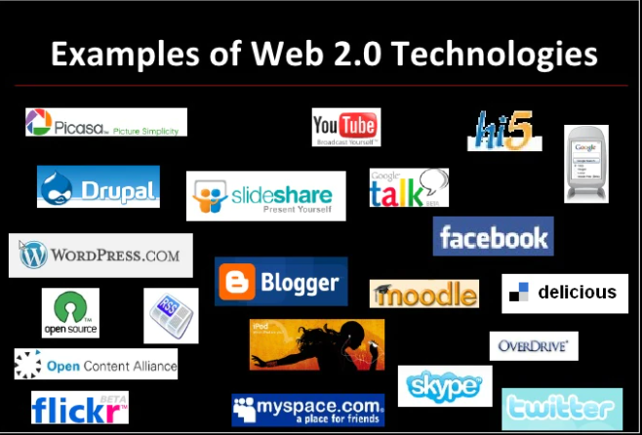
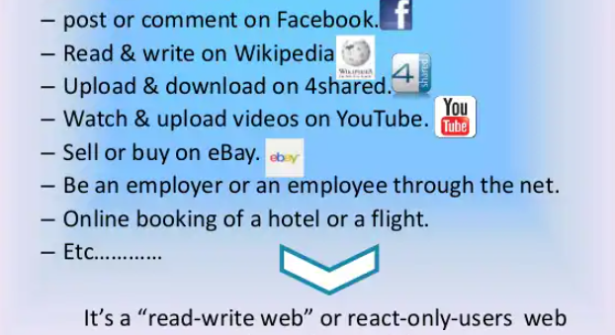
Web 2.0 examples

Slide 37
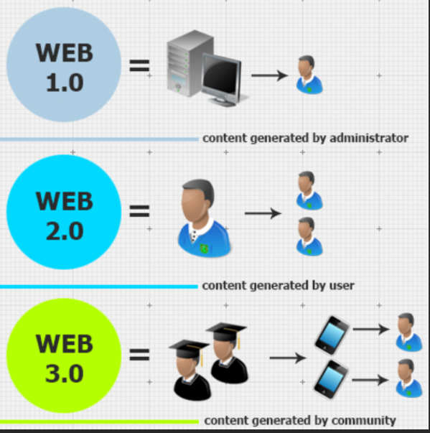
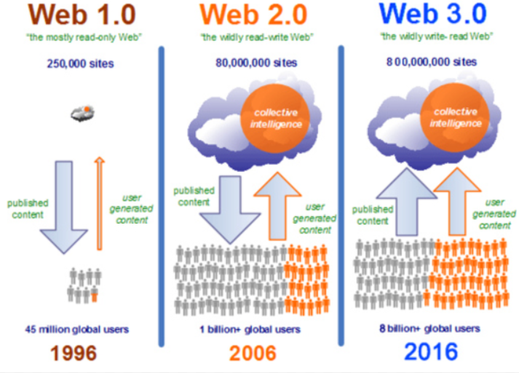
Comparision

Slide 38
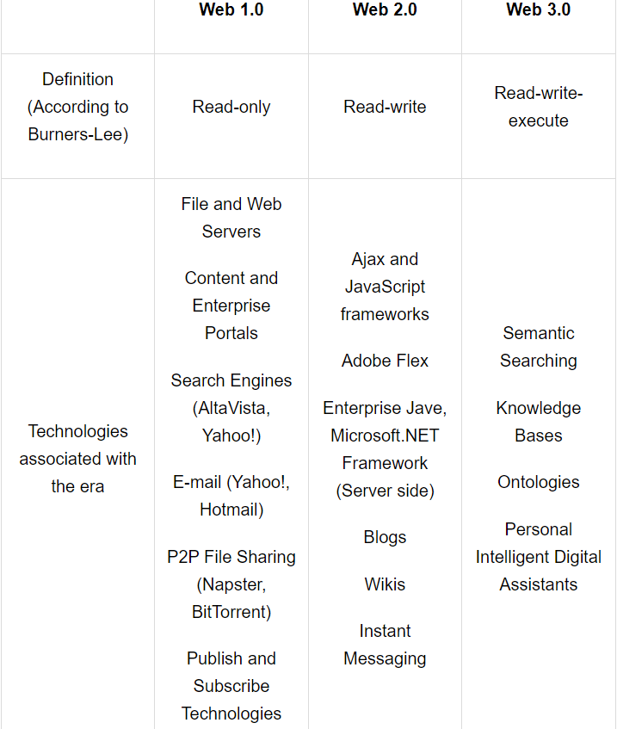

Slide 39
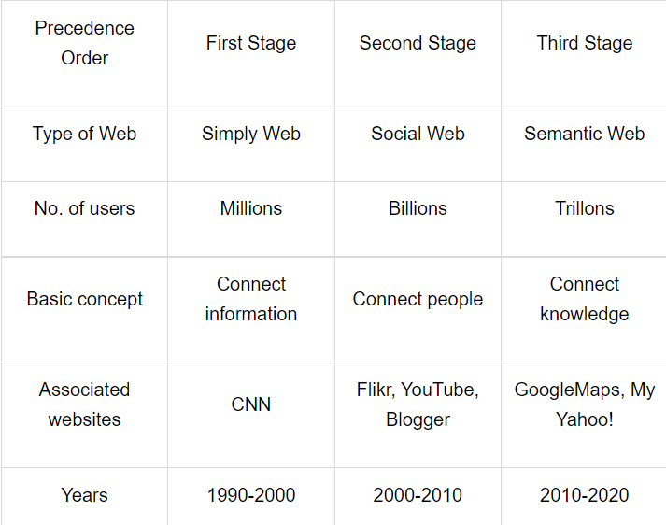

Slide 40
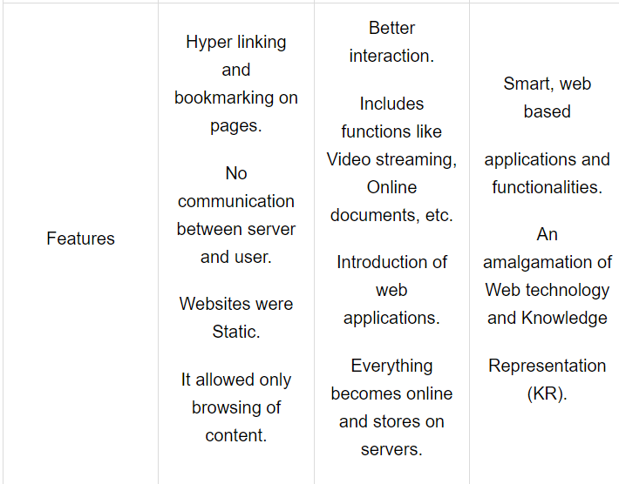

Slide 41
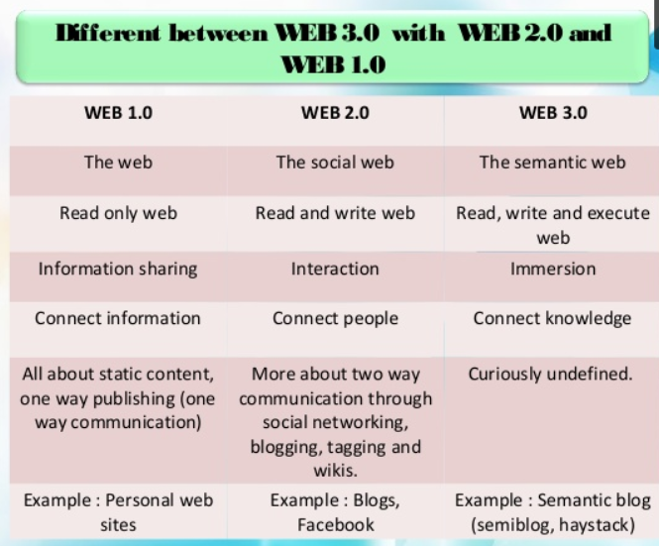

Slide 42
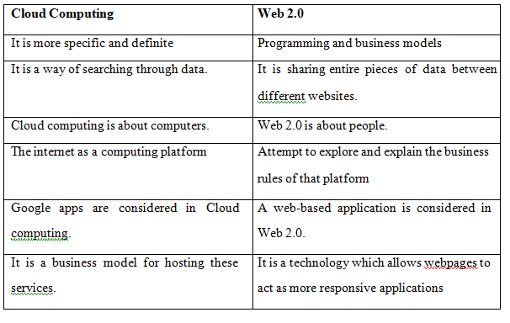
Difference: Cloud and Web 2.0

Slide 43
Key challenges in cloud computing
There are also many challenges involved in cloud computing, and if public are not prepared to deal with them, they won’t realize the benefits.
Here are six common challenges to be considered before implementing cloud computing technology.

Slide 44
Key challenges in cloud computing
Cost
Service Provider Reliability
Downtime
Password Security
Data privacy
Vendor lock-in

Slide 45
Key challenges in cloud computing
Cost
Cloud computing itself is affordable, but tuning the platform according to the company’s needs can be expensive.
Furthermore, the expense of transferring the data to public clouds can prove to be a problem for short-lived and small-scale projects.
Companies can save some money on system maintenance, management, and acquisitions.
But they also have to invest in additional bandwidth, and the absence of routine control in an infinitely scalable computing platform can increase costs.

Slide 46
Key challenges in cloud computing
Service Provider Reliability
The capacity and capability of a technical service provider are as important as price.
The service provider must be available when user need them.
The main concern should be the service provider’s sustainability and reputation.
Make sure you comprehend the techniques via which a provider observes its services and defends dependability claims.

Slide 47
Key challenges in cloud computing
Downtime- is a computer industry term for the time during which a computer or IT system is unavailable
Downtime is a significant shortcoming of cloud technology.
No seller can promise a platform that is free of possible downtime.
Cloud technology makes small companies reliant on their connectivity, so companies with an untrustworthy internet connection probably want to think twice before adopting cloud computing.

Slide 48
Key challenges in cloud computing
Password Security
Industrious password supervision plays a vital role in cloud security.
However, the more people you have accessing your cloud account, the less secure it is.
Anybody aware of your passwords will be able to access the information you store there.
Businesses should employ multi-factor authentication and make sure that passwords are protected and altered regularly, particularly when staff members leave.
Access rights related to passwords and usernames should only be allocated to those who require them.

Slide 49
Key challenges in cloud computing
Data privacy
Sensitive and personal information that is kept in the cloud should be defined as being for internal use only, not to be shared with third parties.
Businesses must have a plan to securely and efficiently manage the data they gather.

Slide 50
Key challenges in cloud computing
Vendor lock-in
Entering a cloud computing agreement is easier than leaving it.
“Vendor lock-in” happens when altering providers is either excessively expensive or just not possible.
It could be that the service is nonstandard or that there is no viable vendor substitute.
It comes down to buyer carefulness. Guarantee the services you involve are typical and transportable to other providers, and above all, understand the requirements.
Cloud computing is a good solution for many businesses, but it’s important to know what you’re getting into.
Having plans to address these six prominent challenges first will help ensure a successful experience.

Slide 51
Cloud players
Top 5 cloud players
1 Microsoft
2 Amazon
3 IBM
4 Salesforce.com
5 SAP

Slide 52
INTRODUCTION OF VIRTUALIZATION
Virtualization is a technique, which allows to share single physical instance of an application or resource among multiple organizations or tenants (customers)..
Virtualization is a proved technology that makes it possible to run multiple operating system and applications on the same server at same time.
Virtualization is the process of creating a logical(virtual) version of a server operating system, a storage device, or network services.
The technology that work behind virtualization is known as a virtual machine monitor(VM), or virtual manager which separates compute environments from the actual physical infrastructure.

Slide 53
Virtualization
Grid Approach - where the processing workloads are distributed among different physical servers, and their results are then collected as one.
OS - Level Virtualization -Here, multiple instances of an application can run in an isolated form on a single OS
Hypervisor-based Virtualization-With hypervisor's virtualization, there are various sub- approaches to fulfill the goal to run multiple applications & other loads on a single physical host

Slide 54
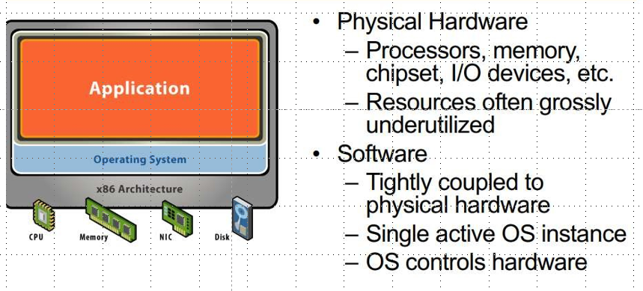
Starting point-a physical machine

Slide 55
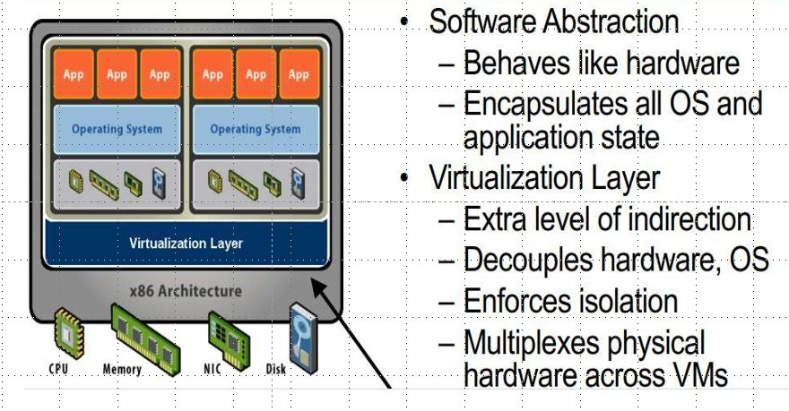
VIRTUAL machine

Slide 56
concept behind the Virtualization
Creation of a virtual machine over existing operating system and hardware.
Host machine: The machine on which the virtual machine is created.
Guest machine: virtual machines referred as a guest machine.
Hypervisor: Hypervisor is a firmware or low-level program that acts as a Virtual Machine Manager.

Slide 57
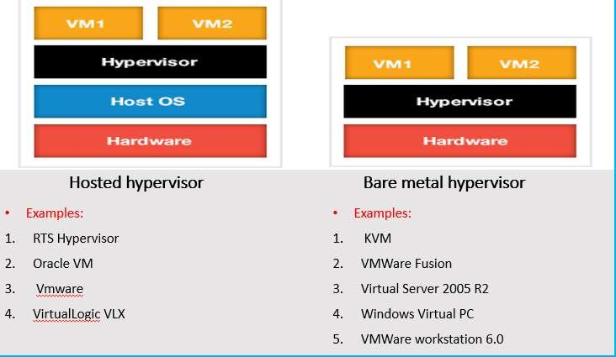
ARCHITECTURE OF VITUALIZATION
Hypervisor- also known as a virtual machine monitor or VMM, is software that creates and runs virtual machines (VMs)
Hosted hypervisors- run on top of the operating system (OS) of the host machine
Bare metal hypervisor - bare-metal hypervisors run directly on the computing hardware
RTS Hypervisor- can combine any operating system with any x86 processor to suit the needs of the moment.
KVM-Kernel (helps with process and memory management, file systems, device control and networking.)VM
Virtual logix (VLX)-real-time virtualization software and related development tools for embedded systems.
VMware was the first commercially successful company to virtualize the x86 architecture.

Slide 58
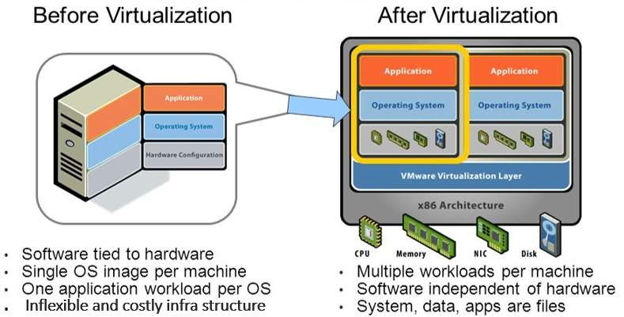

Slide 59
Types of Virtualization
Hardware Virtualization.
Operating system Virtualization.
Server Virtualization.
Storage Virtualization.

Slide 60
1. Hardware Virtualization
When the virtual machine software or virtual machine manager (VMM) is directly installed on the hardware system is known as hardware virtualization.
The main job of hypervisor is to control and monitoring the processor, memory and other hardware resources.
Usage:
Hardware virtualization is mainly done for the server platforms, because controlling virtual machines is much easier than controlling a physical server.

Slide 61
Virtualization
Hardware Virtualization -It is the abstraction of computing resources from the software that uses cloud resources. It involves embedding virtual machine software into the server's hardware components. That software is called the hypervisor.

Slide 62
Virtualization
Three types of hardware virtualizations
Full Virtualization - Here the hardware architecture is completely simulated. Guest software doesn't need any modification to run any applications
Emulation Virtualization - Here the virtual machine simulates the hardware & is independent. Furthermore, the guest OS doesn't require any modification
Para-Virtualization - Here, the hardware is not simulated; instead the guest software runs its isolated system

Slide 63
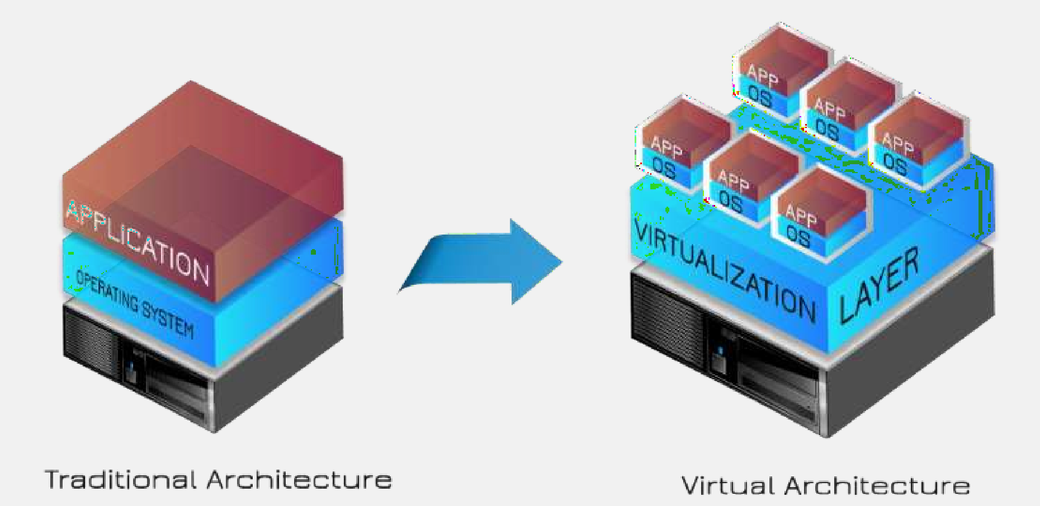

Slide 64
2. Operating System Virtualization
When the virtual machine software or virtual machine manager (VMM) is installed on the Host operating system instead of directly on the hardware system is known as operating system virtualization.
Usage:
Operating System Virtualization is mainly used for testing the applications on different platforms of OS.

Slide 65
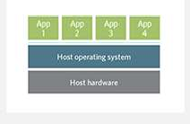
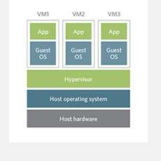
Traditional Operating system Architecture
Virtual Operating system Architecture

Slide 66
3. Server Virtualization:
When the virtual machine software or virtual machine manager (VMM) is directly installed on the Server system is known as server virtualization.
Usage:
Server virtualization is done because a single physical server can be divided into multiple servers on the demand basis and for balancing the load.

Slide 67
Server virtualization:
In this process, the server resources are kept hidden from the user.
This partitioning of physical server into several virtual environments; result in the dedication of one server to perform a single application or task.
This technique is mainly used in web-servers which reduces the cost of web-hosting services.
Instead of having separate system for each web-server, multiple virtual servers can run on the same system/computer.

Slide 68
Primary uses of server virtualization
To centralize the server administration
Improve the availability of server
Helps in disaster recovery
Ease in development & testing
Make efficient use of server resources.

Slide 69
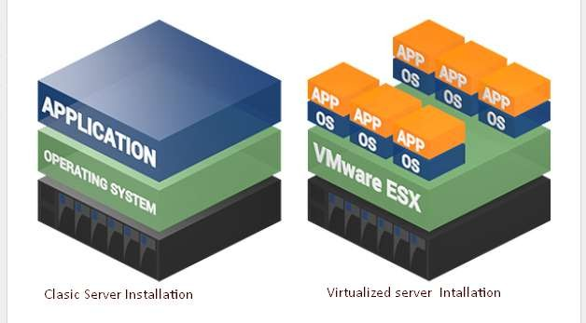

Slide 70
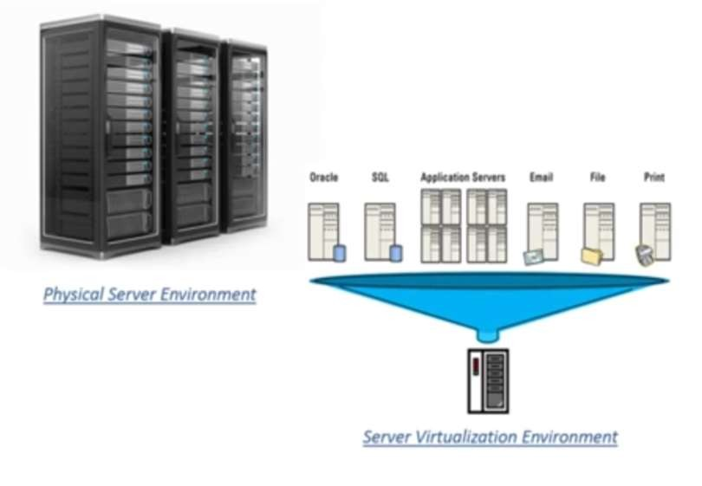

Slide 71
4. Storage Virtualization
Storage virtualization is the process of grouping the physical storage from multiple network storage devices so that it looks like a single storage device.
Storage virtualization is also implemented by using software applications.
Usage:
Storage virtualization is mainly done for back-up and recovery purposes.

Slide 72
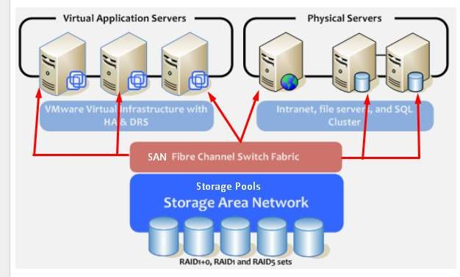

Slide 73
Software virtualization
It is also called application virtualization
Software virtualization is similar to that of virtualization except that it is capable to abstract the software installation procedure and create virtual software installation. Many applications & their distributions became typical tasks for IT firms and departments. The mechanism for installing an application differs.
So virtualized software is introduced in which an application that will be installed into its self-contained unit and provide software virtualization. Some of the examples are Virtual Box, VMware, etc
Benefits are Ease of Client Deployment , Software Migration, Easy to Manage

Slide 74
Cloud vs Virtualization
Cloud computer is internet based computing where virtual shared provide Software, Infrastructure, platform.
Virtualized
API
Pay-as-per-use
Scalability
Virtualization can exist without the cloud but cloud computing cannot exist without virtualization

Slide 75
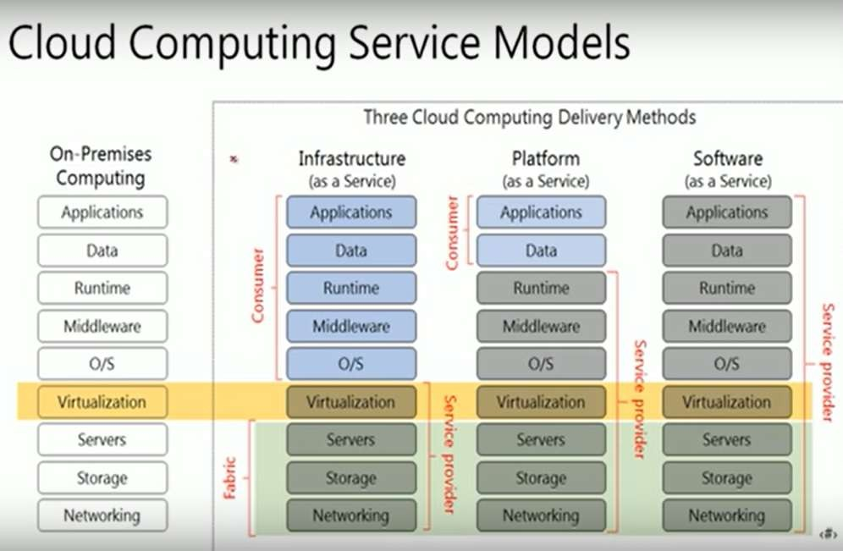

Slide 76
Advantages of Virtualization
Reduced Costs.
Efficient hardware Utilization.
Virtualization leads to better resource Utilization and increase performance
Testing for software development.
Increase Availability
Save energy
Shifting all your Local Infrastructure to Cloud in a day
Possibility to Divide Services
Running application not supported by the host.

Slide 77
Disadvantages of Virtualization
Extra Costs.
Software Licensing.

Slide 78
Approaches or ways to virtualizes cloud servers.
Grid Approach-distributed computing model
OS - Level Virtualization
Hypervisor-based Virtualization
Software virtualization
Hardware virtualization
Server virtualization

Slide 79
Virtualization-summary
Mainly Virtualization means, running multiple operating systems on a single machine but sharing all the hardware resources and it helps us to provide the pool of IT resources so that we can share these IT resources in order get benefits in the business.
One of the main - cost-saving, hardware-reducing, and energy-saving techniques used by cloud providers is virtualization
With OS virtualization each VM can use a different operating system (OS), and each OS is isolated from the others.
Use VMs to enabling different services to run in separate VMs on the same physical machine.

Slide 80
parallelization:
Parallelization is the act of designing a computer program or system to process data in parallel.
Normally, computer programs compute data serially: they solve one problem, and then the next, then the next.
If a computer program or system is parallelized, it breaks a problem down into smaller pieces to be independently solved simultaneously by discrete computing resources.
When optimized for this type of computation, parallelized programs can arrive at a solution much faster than programs executing processes in serial.

Slide 81
parallelization:
Parallelization as a computing technique has been used for many years, especially in the field of supercomputing.
Each new generation of processors approaches the physical limitations of microelectronics, which is a major engineering concern in CPU design.
Because individual chips are approaching their fastest possible speeds, parallel processing becomes an important area where to improve computing performance.
The majority of modern desktop computers and laptops have multiple cores on their CPU that help parallel processing in the operating system.

Slide 82
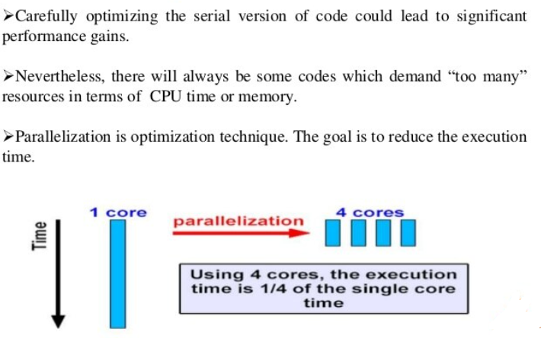
Need for parallelization

Slide 83
Cloud resource management
Critical function of any man-made system.
It affects the three basic criteria for the evaluation of a system like:
Functionality.
Performance.
Cost.

Slide 84
Scheduling
Scheduling in a computing system deciding how to allocate resources of a system, such as CPU cycles, memory, secondary storage space, I/O and network bandwidth, between users and tasks.
Policies and mechanisms for resource allocation.
Policy: principles guiding decisions.
Mechanisms: the means to implement policies

Slide 85
Cloud resource management (CRM) policies
1. Admission control: prevent the system from accepting workload in violation of high-level system policies.
•
2 Capacity allocation: allocate resources for individual activations of a service.
3. Load balancing: distribute the workload evenly among the servers
4. Energy optimization: minimization of energy consumption
5. Quality of service (QoS) guarantees: ability to satisfy timing or other conditions specified by a Service Level Agreement

Slide 86
Dynamic resource allocation
Cloud Computing environment can supply of computing resources on the basis of demand and when needed
Managing the customer demand creates the challenges of on-demand resource allocation.
Effective and dynamic utilization of the resources in cloud can help to balance the load and avoid
situations like slow run of systems.
Cloud computing allows business outcomes to scale up and down their resources based on needs.
Virtual Machines are allocated to the user based on their job in order to reduce the number of physical servers in the cloud environment
If the VM is available then job is allowed to run on the VM.
If the VM is not available then the algorithm finds a low priority job taking into account the job’s lease type.

Slide 87
There are three types
Cancellable: These requests can be scheduled at any time after their arrival time
Suspendable: Suspendable leases are flexible in start time and can be scheduled at any time after their ready time
Non-Preemptable: The leases associated with such requests cannot be pre-empted at all.

Slide 88
Optimal allocation of cloud models
The optimal allocation of computing resources is a core part for implementing cloud computing.
High heterogeneity, high dynamism, and virtualization make the optimal allocation problem more complex than the traditional scheduling problems in grid system or cloud computing system.

Slide 89
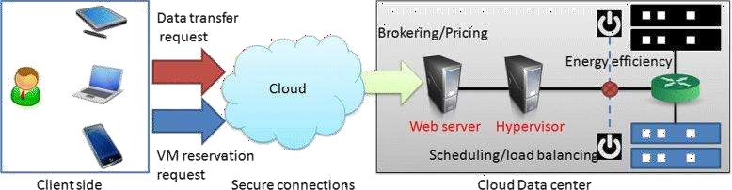
Optimal allocation of cloud models

